Slide 1

AUTOMATIC TEST CASE GENERATION TO EXPLORE PARAMETERS OF CRASH SCENARIOS IN SELF DRIVING CARS
Sameed Tariq – 82142
Master in Computer Science
Supervisor: Prof. Dr.-Ing. Gordon Fraser Advisor: Dr. Alessio Gambi

Slide 2
Problem Statement
Explore the parameters and evaluate the accuracy of the inaccurate car crash report to identify the critical scenarios in reconstruction car crash to enhance the safety of autonomous vehicles.
Proposed Solution
Automatic test case generation to explore the parameters such as velocity, steering angle and aftermath position, rotations in car crash report of self-driving cars.

Slide 3
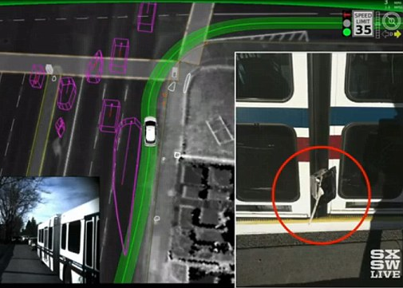
Self Driving Cars Failure
On 14 February the car, travelling at 2mph (3km/h), pulled out in front of a public bus going 15mph (24km/h).
Reason: Google autonomous vehicle assumed the bus would slow down to let the car out, and so he did not override the car's self-driving computer.
https://www.dailymail.co.uk/sciencetech/article-3491916/Google-admits-self-driving-car-got-wrong-Bus-crash-caused-software-trying-predict-driver-do.html

Slide 4
Motivation
Inaccurate car crash description
For Example Velocity and Steering Angle.
Initial Position of vehicle on the road is not given.
Damages of Cars – Point of Impact
Speed adjustment of autonomous car to avoid accidents (non critical scenarios).
Testing of car controlling software and decision making.
Wrong assumption may lead to unpredictable scenario.

Slide 5
Methodology
Data Extraction (Natural Language Processing)
Road Network Extraction (Images)
Open Street Map Scenario Extraction – (Optional)
Generation of Scenario.
Car Crash Simulation in BeamNG
Parameter Tuning
Evaluation

Slide 6
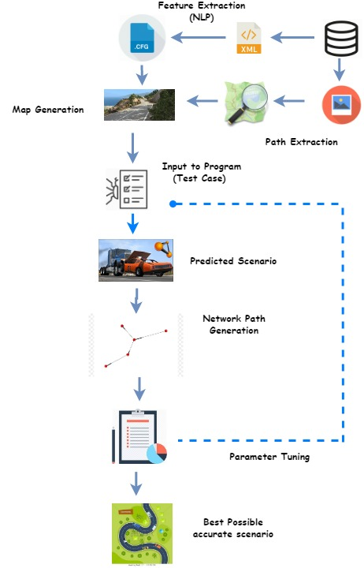
Architecture Diagram

Slide 7
Data Acquisition
Source: NHTSA Database
Police Crash Report according to NHTSA guidelines.
Summary Extraction
Pre-crash Event | Crash Event | After-crash Event | Environmental Factors.
Natural Language Processing Technique such Subject Verb Object and Named Entity Recognition.
Images Extraction
Network Path Generation for road generation and geometry extraction from Open Street Map

Slide 8
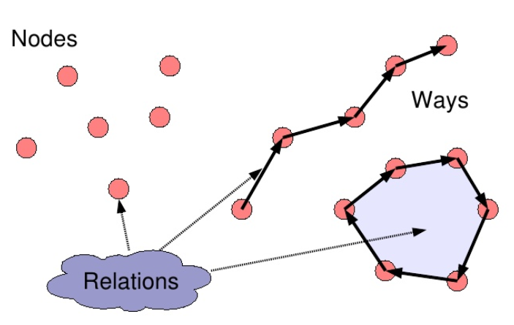
Open Street Map Extraction (Optional)
Open Source geospatial data to use and share.
Essential for initial geometry of roads path and other ways.
Customized Parser to extract the roads from the specific region that match the description in the summary.

Slide 9
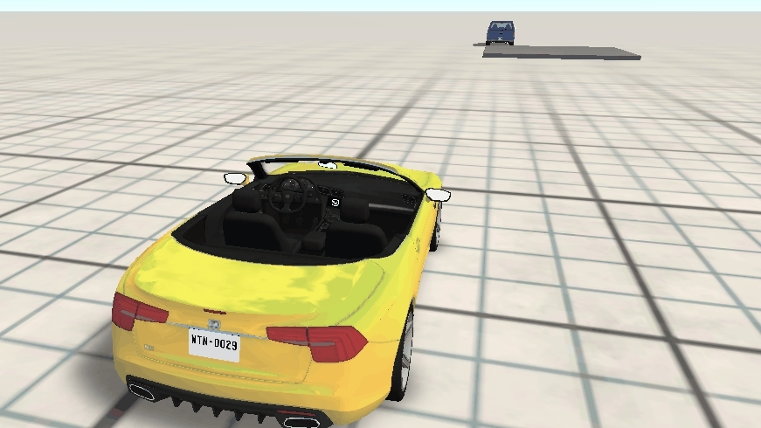

BeamNG Scenario Reconstruction
Striking Car
Environmental configuration
Trajectory Generation
Static and dynamic objects
Victim Car
Environmental configuration
Trajectory Generation
Static and dynamic objects
https://homdor.com/simulation/nextobedientasianlion/detail

Slide 10
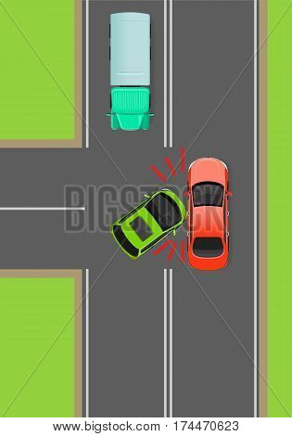
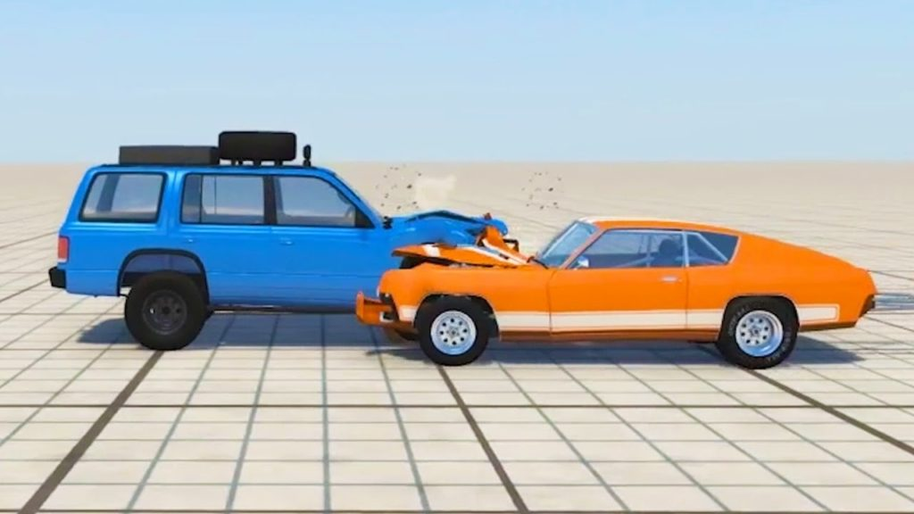
Car Crash Simulation BeamNG
Quickly” identify the critical boundaries (i.e., under which conditions the car crashes)
https://www.bigstockphoto.com/image-174470623/stock-vector-clash-of-cars-on-t-junction-flat-vector-illustration-road-rules-violations-example-on-top-view-diagram-traffic-offences-concept-car-crash-and-car-accident-for-insurance-company%2C-driving-courses-ad
http://www.topcarcrashes.com/car-crash-at-200mph-in-slow-motion-beamng-drive/

Slide 11
Information Extraction from BeamNG
In BeamNG Simulation, we can extract the following information
Position of Striking Car at different timestamp
Speed of Victim Car at different timestamp
Car Damage at different points of the car.
For Example Back, Forward, Right Side and Left Side.
Target
1. Position of the car after impact
2. Rotation of car after impact.

Slide 12
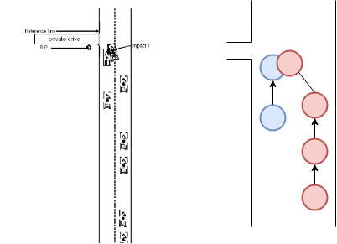
Parameter Tuning
The parameters to estimate the accurate trajectory and determination of collision and non-collision scenarios.
Velocity
Initial Position
Acceleration

Slide 13
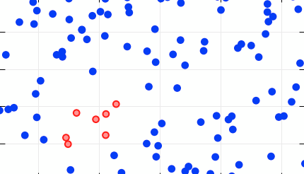
Evaluation
For each crash report, the critical and non critical scenarios will be estimated
Speed of victim car
Speed of Striking car
Number of simulations will be executed to get the best possible trajectory
The best K simulations will be selected for evaluation
Velocity of Striking Car | Velocity of Victim Car | Crash Point of Striking Car | Crash point of Victim Car | Position of striking car after impact | Position of victim car after impact | Rotation / Direction of striking car | Rotation / Direction of victim car

Slide 14
Conclusion
The method attempts to identify the critical, non critical scenarios, aftermath of autonomous car and estimating the velocity, acceleration of the striking and victim car that is not currently given in the crash report.

Slide 15
Thank You
Any Questions ?

Slide 16
References
BeamNG GmbH. BeamNG.research.
NHTSA Database. https://crashviewer.nhtsa.dot.gov/LegacyCDS/Search
OpenStreetMap. Osm xml, 2017. http://wiki.openstreetmap.org/wiki/OSM XML.

